Slide 1
YACC Parser Generator

Slide 2
YACC
YACC (Yet Another Compiler Compiler)
Produce a parser for a given grammar.
  Compile a LALR(1) grammar
Original written by Stephen C. Johnson, 1975.
Variants:
  lex, yacc (AT&T)
  bison: a yacc replacement (GNU)
  flex: fast lexical analyzer (GNU)
  BSD yacc
  PCLEX, PCYACC (Abraxas Software)

Slide 3
How Does YACC Work?
y.tab.h
yacc
YACC source (*.y)
y.tab.c
y.output
Generate a new parser code from grammar
C compiler/linker
y.tab.c
a.out
Compile a new parser
Abstract
Syntax
Tree
a.out
Token stream
Parse source code

Slide 4
YACC Format
%{
  C declarations
  %}
  yacc declarations
  %%
  Grammar rules
  %%
  Additional C code

Slide 5
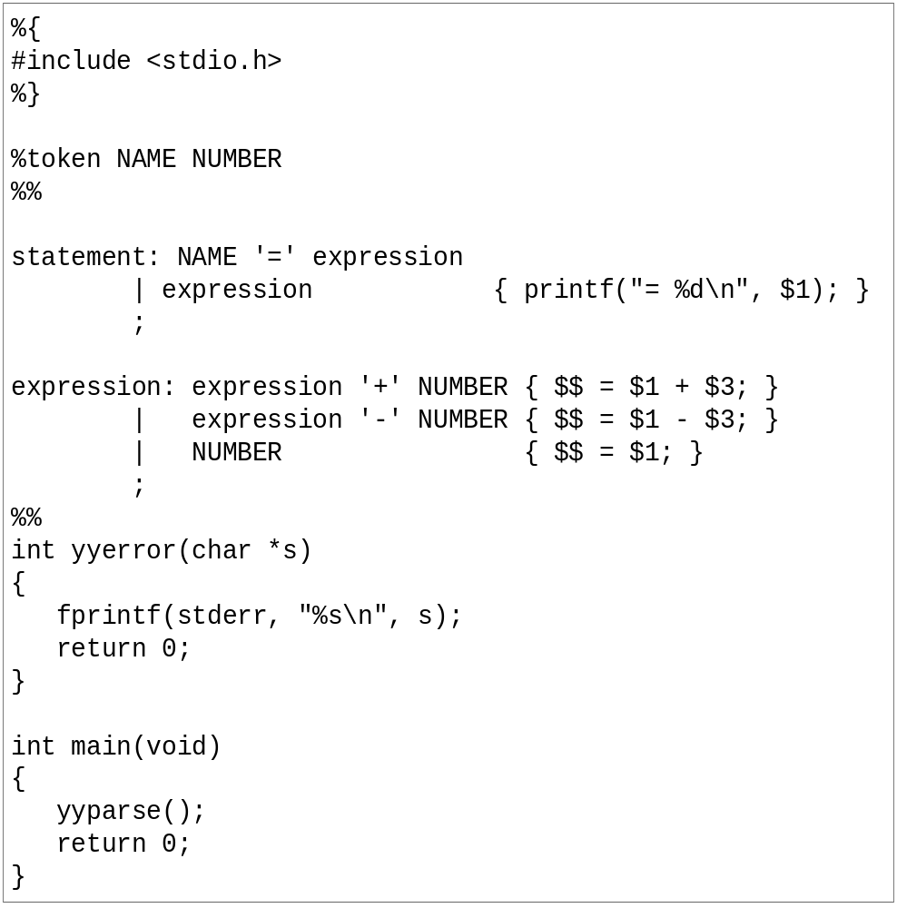
YACC Example
C declarations
yacc declarations
Grammar rules
Additional C code

Slide 6
YACC Declarations Section
%{
#include <stdio.h>
#include <stdlib.h>
%}
%token ID NUM
%start expr
Terminal
Start Symbol

Slide 7
YACC Declaration Summary
`%start'
Specify the grammar's start symbol
`%union'
Declare the collection of data types that semantic values may have
`%token'
Declare a terminal symbol (token type name) with no precedence or associativity specified
`%type'
Declare the type of semantic values for a nonterminal symbol

Slide 8
YACC Declaration Summary
`%right'
Declare a terminal symbol (token type name) that is
right-associative
`%left'
Declare a terminal symbol (token type name) that is left-associative
`%nonassoc'
Declare a terminal symbol (token type name) that is nonassociative
(using it in a way that would be associative is a syntax error,
ex: x op. y op. z is syntax error)

Slide 9

Grammar Rules Section
Normally written like this
Example:
expr : expr '+' term
| term
;
term : term '*' factor
| factor
;
factor : '(' expr ')'
| ID
| NUM
;

Slide 10
Work between LEX and YACC
Use enumeration / define
  YACC produce y.tab.h
  LEX include y.tab.h
  yacc -d gram.y
    Will produce y.tab.h

Slide 11
YACC and Bison Command
Yacc (AT&T)
  yacc –d xxx.y
Bison (GNU)
  bison –d –y xxx.y
Produce y.tab.c, the same as above yacc command

Slide 12
Work between LEX and YACC
%{
#include <stdio.h>
#include "y.tab.h"
%}
id [_a-zA-Z][_a-zA-Z0-9]*
%%
int { return INT; }
char { return CHAR; }
float { return FLOAT; }
{id} { return ID;}
scanner.l
yacc -d xxx.y
Produced
y.tab.h
# define CHAR 258
# define FLOAT 259
# define ID 260
# define INT 261
%{
#include <stdio.h>
#include <stdlib.h>
%}
%token CHAR, FLOAT, ID, INT
%%
parser.y

Slide 13
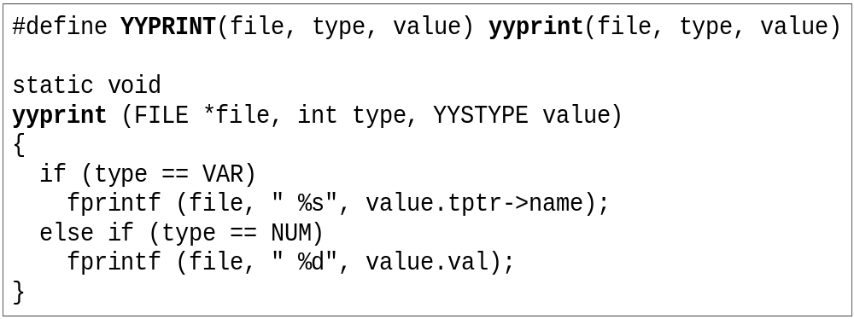
Debug YACC Parser
Use –t option or define YYDEBUG to 1.
Set variable yydebug to 1 when you want to trace parsing status.
If you want to trace the semantic values
  Define your YYPRINT function

Slide 14
Simple Calculator Example - Files
calc.l
  Specifies the lex command specification file that defines the lexical analysis rules.
calc.y
  Specifies the yacc command grammar file that defines the parsing rules, and calls the yylex subroutine created by the lex command to provide input.

Slide 15
Simple Calculator Example – YACC File
%{
#include <stdio.h>
int regs[26];
int base;
%}
%start list
%token DIGIT LETTER
%left '|'
%left '&'
%left '+' '-'
%left '*' '/' '%'
%left UMINUS /*supplies precedence for unary minus */
parser.y

Slide 16
Simple Calculator Example – YACC File
%% /* beginning of rules section */
list: /*empty */
|
list stat '\n'
|
list error '\n'
{
yyerrok;
}
;
stat: expr
{
printf("%d\n",$1);
}
|
LETTER '=' expr
{
regs[$1] = $3;
}
;
expr: '(' expr ')'
{
$$ = $2;
}
|
expr '*' expr
{
$$ = $1 * $3;
}
|
expr '/' expr
{
$$ = $1 / $3;
}
|
expr '%' expr
{
$$ = $1 % $3;
}
|
expr '+' expr
{
$$ = $1 + $3;
}
|
expr '-' expr
{
$$ = $1 - $3;
}
|
expr '&' expr
{
$$ = $1 & $3;
}
|
expr '|' expr
{
$$ = $1 | $3;
}
|

Slide 17
Simple Calculator Example – YACC File
'-' expr %prec UMINUS
{
$$ = -$2;
}
|
LETTER
{
$$ = regs[$1];
}
|
number
;
number: DIGIT
{
$$ = $1;
base = ($1==0) ? 8 : 10;
} |
number DIGIT
{
$$ = base * $1 + $2;
}
;

Slide 18
Simple Calculator Example – YACC File
%%
main()
{
return(yyparse());
}
yyerror(s)
char *s;
{
fprintf(stderr, "%s\n",s);
}
yywrap()
{
return(1);
}

Slide 19
Simple Calculator Example – Lex File
%{
#include <stdio.h>
#include "y.tab.h"
int c;
extern int yylval;
%}
%%
" " ;
[a-z] {
c = yytext[0];
yylval = c - 'a';
return(LETTER);
}
[0-9] {
c = yytext[0];
yylval = c - '0';
return(DIGIT);
}
[^a-z0-9\b] {
c = yytext[0];
return(c);
}

Slide 20
Simple Calculator Example – Compile and Run
bison -d –y calc.y
  create y.tab.c and y.tab.h
flex calc.l
  create lex.yy.c
gcc -g lex.yy.c y.tab.c -o calc
  Create execution file
./calc
  Run the calculator

